Slide 1

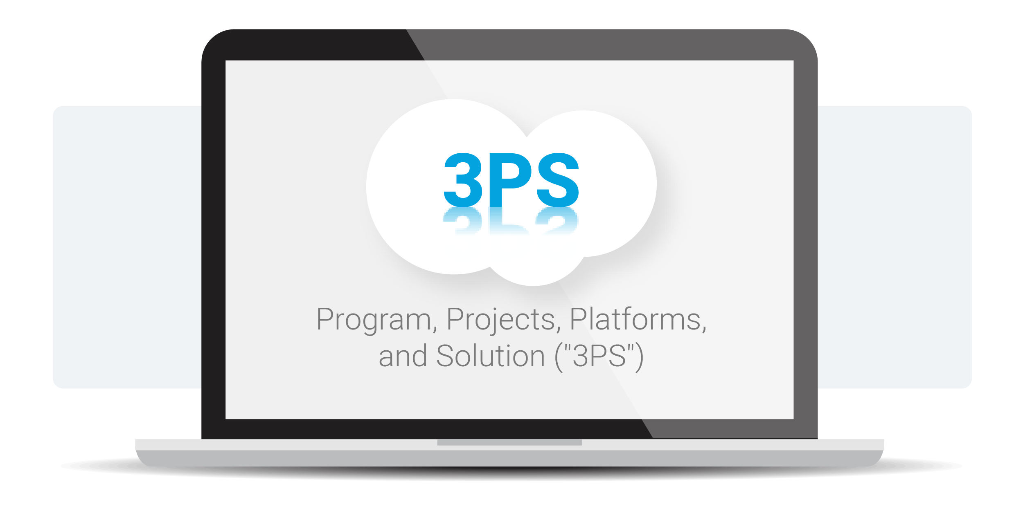
YPO eCommerce Summit – March 2022
A B2B eCommerce Playbook
a.k.a “The CIM Playbook”
CIM = Customer Interaction Management
Ecommerce + CRM Tools + ERP Integration
Using the 3PS Framework ™

Slide 2

Your CIMcloud Presenter
A B2B eCommerce (CIM) Playbook
Brian Seidel
YPO S7, CEO & Co-Founder of CIMcloud
brian.seidel@cimcloud.com

Slide 3
AUDIENCE
POLL
% B2B, Ecom Site, Physical Product, Platform vs. Custom, ERP / Accounting

Slide 4

Presentation Goal
Have You Ever Heard / Said This?
“Why is this so f**king hard?”
“You’re killing our online business!”
“This project is a never-ending money pit… with no ROI”
“You are the worst vendor/partner we’ve ever had.”
“We need to re-platform our site.”
“We can’t do this with out current ERP system.”

Slide 5
Today’s Agenda
Why? The Business Case
The Ultimate B2B Goal/Vision & Key Driver to Get There
Intro To The 3PS Framework
A Proven Approach For Long-Term CIM/eCommerce Success
Program & Projects
One Long-Term Program w/ Lots of Short-Term Projects
Platform(s) vs. Solution
Explaining Your Solution vs. Platform(s) You Buy
Critical Roles (“Hats”) to Fill
The Critical Roles That Must Be Filled for Success
First / Next Steps
Six (6) Steps You Can Take Now

Slide 6
Today’s Agenda
Why? The Business Case
The Ultimate B2B Goal/Vision & Key Driver to Get There
Intro To The 3PS Framework
A Proven Approach For Long-Term CIM/eCommerce Success
Program & Projects
One Long-Term Program w/ Lots of Short-Term Projects
Platform(s) vs. Solution
Explaining Your Solution vs. Platform(s) You Buy
Critical Roles (“Hats”) to Fill
The Critical Roles That Must Be Filled for Success
First / Next Steps
A Recap of Three Things You Can Do to Apply These Concepts

Slide 7
Why? The Business Case
The Ultimate “Dream” Goal of B2B Commerce
#1: Dominate Your Market
Grow Sales
Get & keep 100% of your target market.
#2: Maximize Operational Efficiency
Not Headcount
You customers self-service for 100% of their interactions.
GROW SALES,
NOT HEADCOUNT

Slide 8

Why? The Business Case
The Effortless Experience
“Leading companies are making it easy to help customers help themselves – and are rewarded by increased loyalty.”
“...customers see just as much value in self-service as they do in phone interactions... this is nowhere near what executives expected… a 2.5:1 margin in favor of phone service.”

Slide 9
Why? The Business Case
The Effortless Experience
Point #1: Low Customer Effort
Loyalty = Keep & Grow Customers
Key To Loyalty = Low Customer Effort
Point #2: Focus on Customer Self-Service
#1 Tactic for Lowering Effort = Customer Self-Service
B2B eCommerce (ERP Integrated) = Double-Win
Grow Sales: Get, Keep, Grow Customers
Not Headcount: Interact Better, Faster, Cheaper

Slide 10

Why? The Business Case
Goal #1: Dominate Your Market
GROW SALES
TACTICS
KEY DRIVER
LOYALTY
DOMINATE
YOUR
MARKET
Tactic #1:
Customer Self-Service
Low
Customer Effort
Get, Keep & Grow
Customers

Slide 11
Why? The Business Case
Goal #2: Maximize Operational Efficiency
CUSTOMERS CAN & DO
SELF-SERVICE EVERYTHING
NOT HEADCOUNT
Tactic #1:
Customer Self-Service
MAXIMIZE
OPERATIONAL
EFFICIENCY
Tactic #3:
Integrate With Your Backend ERP System
WORKERS CAN SEE & ACCESS
ALL CUSTOMER, EMPLOYEE
& BACKEND DATA
Tactic #2:
Employee Visibility

Slide 12
Why? The Business Case
Tactics and Goals (Combined)
GROW SALES
ECOMMERCE
Tactic #1:
Customer
Self-Service
Low
Customer
Effort
Get, Keep
& Grow
Customers
DOMINATE
YOUR
MARKET
NOT HEADCOUNT
REP TOOLS (CRM-STYLE)
ERP SYNC
Tactic #3:
Integrate With Your Backend ERP System
MAXIMIZE
OPERATIONAL
EFFICIENCY
Tactic #2:
Employee Visibility

Slide 13
Why? The Business Case
What Can You Shift to Online Customer Self-Service?
Product Catalog Management
What parts go with this item?
What new products do you have/what do you recommend?
Is there a replacement for this item available?
What part do I need that fits these requirements?
What is the part number for this item (in my hand)?
Can you send me an MSDS sheet?
Can you send me an instruction manual/spec data
Is this in stock in the Philadelphia warehouse?
What’s my price on this item?
When will this item ship?
Do I get a better price if I order larger quantity?
Can you help me order a highly configurable product?
How do I send you the variable data you need?
What is the min qty, max qty, increment?
What UOMs is this available in?
Can you send me a price sheet every Monday?
Can you send me a stock report every night?
Can you show me my skus on your products?
Can I add my own descriptions to your products?
Can you send me a list of my custom products?
Quote Management
Can you send me a quote on this product?
What is the cost to ship?
Can you revise this quote and resend it?
Is this price still valid?
Order Management
I need to place an order
Did you get my order yet?
Did it ship yet/When will it be here?
Did my change order go through?
Can I change that order I just placed?
Can you tell me my backorder report/list of backordered items?
Can you send me a copy of the last 10 orders I placed with you?
Can I reorder the same products from last month?
Can you just ship me this every month?
Can I give you my order now, but don’t place it until next week?
What’s the status of my order?
What’s the minimum order on this product?
How many times have I ordered this product?
How much have I spent with you this year?
How much have I spent on this product this month?
What are my most frequently purchased items?
Can you ship that via FedEx Overnight?
How much are different shipping options?
Can you apply this coupon code/is it still valid?
Can I use my gift certificate on this?
Don’t I qualify for a promotion/ What promotions are running?
Does this qualify for free shipping?
Can you bill the shipping to my UPS (etc) account?
Can you ship this out of the XYZ warehouse?
Can I pick this up at the store?
Can you drop-ship this to my customer?
Does this order put me over my credit limit?

Slide 14
Why? The Business Case
What Can You Shift to Online Customer Self-Service?
Payment Collections Management
Can you resend me these invoices?
What’s my current aging report
How much do I owe you/can you send me a statement?
How much do I still owe on this invoice?
Was my payment applied?
Did you get my payment?
Which invoice(s) was my payment applied to?
Was my credit applied - and which invoices was it applied to?
What order are those invoices for?
What shipments are tied to this invoice?
How many days do I have to pay?
When is payment due?
Can you send me a past-due balance
What’s my credit limit?
How much available credit do I have?
When’s the last time I made a payment?
How much have I paid you this year?
Can you send me a list of my payments?
What was the check number on that payment?
What credit card was used for this payment?
What was that credit on my account for?
What credit cards do I have on file with you?
Can you charge that to my credit card on file?
Can you automatically draft my bank account when invoices are due?
How do I dispute this invoice?
What was invoice XYZ for?
Returns and Claims Management
How do I make a return?
Can I return this item?
Where do I ship this return to?
Do I have to pay return shipping on this?
Was my return request approved?
Can you give me an RMA number for this?
Do I need a special packing slip/return label for this?
Did you receive the items I returned yet?
Do I actually have to send this defective item back, or can I send a picture of it?
Did my item qualify for a full refund?
Did you credit me for my return yet?
How much did I get credited on this return?
Is this part still under warranty?
Can you ship me a replacement?
Can I see the work/service/claims history on this machine?
Can you email me when you receive my return?
Can you email me when my credit has been applied?
Ad Hoc Requests
Can I change my billing address?
I have a new expiration date for my credit card
Can you change the credit card I have on file?
Can you change the ACH bank account on file?
I need to change my email address
We have a new billing contact
Can we add another approved ship-to address?
What are the shipper account numbers I have on file?
I need to edit my UPS account number
John Doe no longer works here - can you update that in your files?

Slide 15
Today’s Agenda
Why? The Business Case
The Ultimate B2B Goal/Vision & Key Driver to Get There
Intro To The 3PS Framework ™
A Proven Approach For Long-Term CIM/eCommerce Success
Program & Projects
One Long-Term Program w/ Lots of Short-Term Projects
Platform(s) vs. Solution
Explaining Your Solution vs. Platform(s) You Buy
Critical Roles (“Hats”) to Fill
The Critical Roles That Must Be Filled for Success
First / Next Steps
A Recap of Three Things You Can Do to Apply These Concepts

Slide 16
Introduction To The 3PS Framework ™
The 3PS Framework ™
PROGRAM
A long-term series of Projects focused on 1) allowing customers to self-service (to drive loyalty), 2) increasing employee visibility, and 3) integrating with existing systems.
PROJECT(S)
The individual steps taken, within the overall Program, to add capabilities to your Solution and/or increase it’s adoption/usage by customers and employees.
PLATFORM(S)
The third-party software Platform(s) that you implement to serve as the foundation of your Solution.
SOLUTION
The online Solution (Platforms + customizations + data/configs) you roll-out to customers and employees through Projects working towards your Program vision.

Slide 17
Today’s Agenda
Why? The Business Case
The Ultimate B2B Goal/Vision & Key Driver to Get There
Intro To The 3PS Framework
A Proven Approach For Long-Term eCommerce Success
Program & Projects
One Long-Term Program w/ Lots of Short-Term Projects
Platform(s) vs. Solution
Explaining Your Solution vs. Platform(s) You Buy
Critical Roles (“Hats”) to Fill
The Critical Roles That Must Be Filled for Success
First / Next Steps
Six (6) Steps You Can Take Now

Slide 18
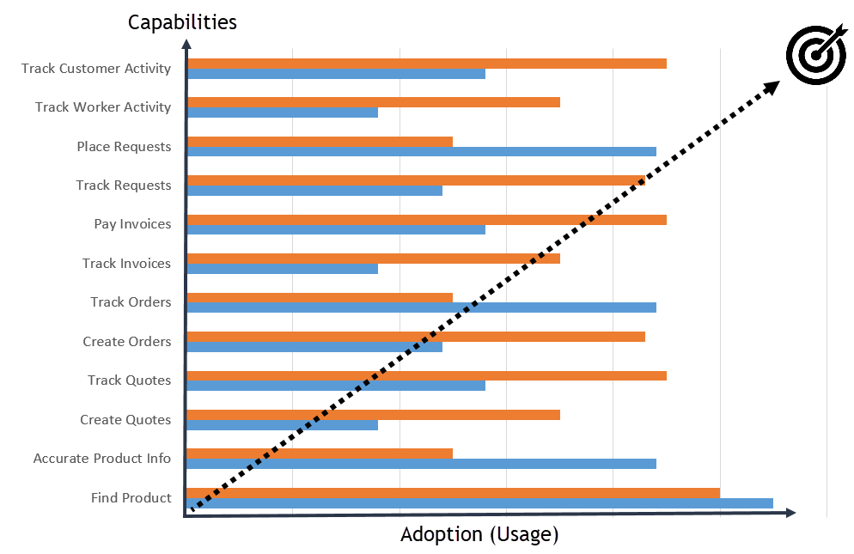

Program & Projects
The Overall Program & It’s Projects
GROW SALES,
NOT HEADCOUNT
The Program is a series of Projects to increase your Solution’s capabilities & adoption as you move towards the dream goal.
Each Project has a written goal (outcomes), budget, and timeline. It requires a written work plan (tasks) and people to manage and do the work.

Slide 19
The Critical Roles
Example CIM Program
Objective: Customers can and do self-service for their needs and all rep & customer activity is logged and visible.
Program Manager:
Janet Johansson
VP of Sales & Marketing
Key Results:
The following key results have been accomplished by 3/31/2024.
50% of customers are self-servicing for product data (images, specs, prices, stock levels, lead-times)
Customers are self-servicing for 50% of quotes & orders
Customers are self-servicing for 95% of shipment tracking
Customers are self-servicing for 50% of AR / aging-related questions
Customers are self-servicing for 50% of invoice payments
Customers are self-servicing for 50% of return requests
Sales reps are centrally logging the stage and outcome of 100% of new customer onboarding opportunities
Reps can see all customer interactions (emails, meetings, phone calls, etc) made between employees and customers
Sales reps are logging and updating 95% of customer and contact “rolodex” data so we have a highly accurate database
100% of our inbound customer requests are logged in a central system
99% of our inbound requests are being responded to in 1 business day with 85% being completed in 3 business days

Slide 20
The Critical Roles
Example Projects (of a CIM Program)
Project #1 (capability)
Outcome = Deploy a customer self-service tracking AR portal that works with our Sage ERP system and allows customers to see orders, shipments, open and past invoices, payments, and credits
Project Manager = Director of Customer Service
Project Budget = $X,000
Project Deadline = 9/15/2022
Project Scope = Defines what deliverables are needed to achieve the outcome
Project Plan = Lines up platform(s), resources, work / actions items needed to hit the scope, budget, and deadline
Project Team = These are the people (in-house and outsourced) that will fill the job functions & execute the plan
Project #2 (adoption)
Outcome = Get 15% of our dealers using the AR portal on a monthly basis
Project Manager = Director of Marketing
Project Budget = $X,000
Project Deadline = X/X/2022
Project Scope = Defines what deliverables are needed to achieve the outcome
Project Plan = Lines up platform(s), resources, work / actions items needed to hit the scope, budget, and deadline
Project Team = These are the people (in-house and outsourced) that will fill the job functions & execute the plan

Slide 21
Today’s Agenda
Why? The Business Case
The Ultimate B2B Goal/Vision & Key Driver to Get There
Intro To The 3PS Framework
A Proven Approach For Long-Term eCommerce Success
Program & Projects
One Long-Term Program w/ Lots of Short-Term Projects
Platform(s) vs. Solution
Explaining Your Solution vs. Platform(s) You Buy
Critical Roles (“Hats”) to Fill
The Critical Roles That Must Be Filled for Success
First / Next Steps
Six (6) Steps You Can Take Now

Slide 22
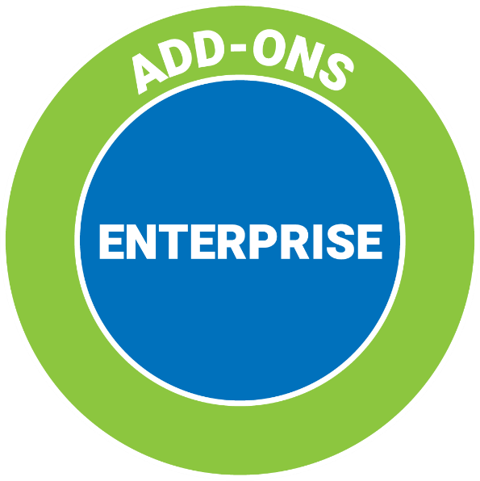
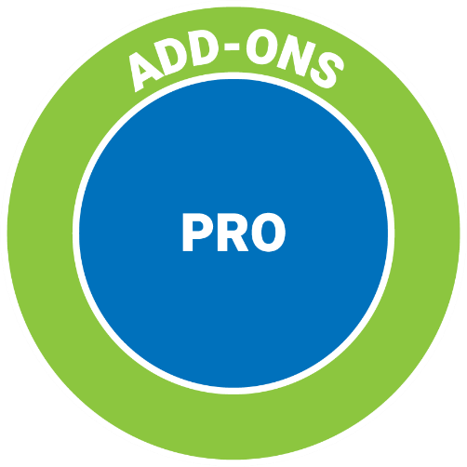

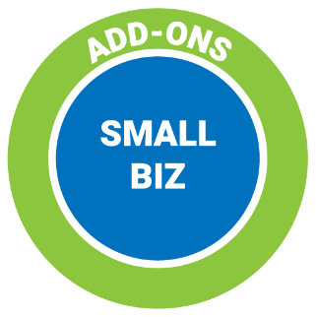
Platform(s) vs. Solution
Platform: Core Layer of Your Ecom Solution

Slide 23
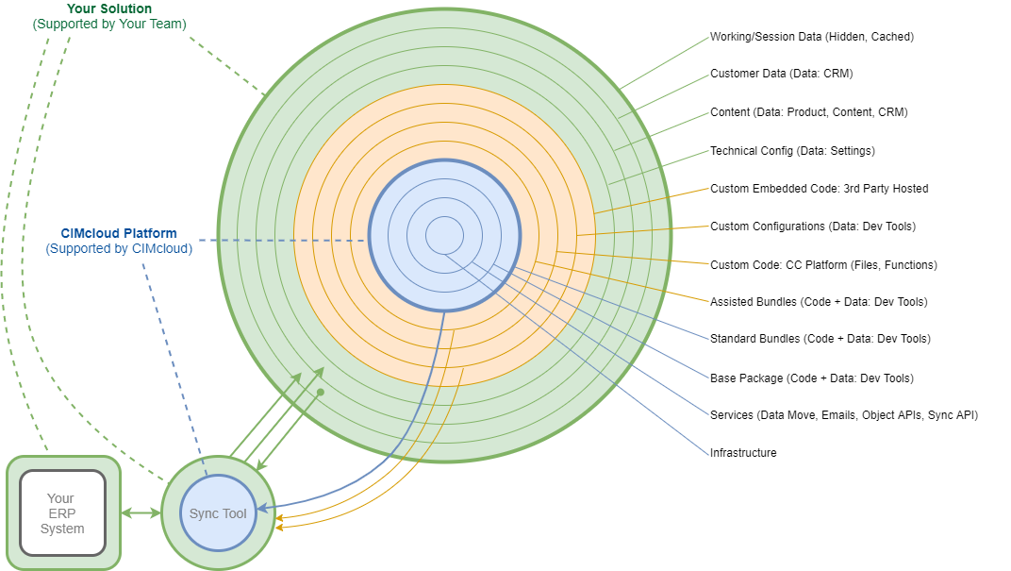
Platform(s) vs. Solution
Your Solution = Platform + Customizations + Data/Config

Slide 24
Today’s Agenda
Why? The Business Case
The Ultimate B2B Goal/Vision & Key Driver to Get There
Intro To The 3PS Framework
A Proven Approach For Long-Term eCommerce Success
Program & Projects
One Long-Term Program w/ Lots of Short-Term Projects
Platform(s) vs. Solution
Explaining Your Solution vs. Platform(s) You Buy
Critical Roles (“Hats”) to Fill
The Critical Roles That Must Be Filled for Success
First / Next Steps
Six (6) Steps You Can Take Now

Slide 25
The Critical Roles
The Right Team Makes A (Massive) Difference
Implementing An Ecommerce Initiative Is Complex
Multiple “Hats” Or Roles Required
Missing Role Assignments Are The Biggest Hurdle (By Far) To Success
Wearing More Than One “Hat” Is Common
The Team Member May Not Be Full-Time
The Team Member May Not Wear The Hat Full-Time

Slide 26






The Critical Roles
Six (6) Critical Roles To Assign Immediately
Program Manager
Project Planner
Lead Project Manager
Lead Implementer & Lead Operator
Onboarding & Adoption Specialist
Solver: Product Manager / Business Analyst

Slide 27

The Critical Roles
Program Manager
The Program Manager is accountable for delivering business results to the organization.
The 4 “Musts”
Be filled by 1 and only 1 person
Be known (who it is) by all parties involved
GWC the role
Take on all 6 key responsibilities
The 6 Key Responsibilities
Maintains a clear (written) vision and goals for the program
Verifies you have the software platform(s) you need to carry out the vision
Decides which projects to do and when to do them (including budget authority)
Makes sure each approved project has clearly written goals, budget, and timeline
Fills the critical roles (see below) on each project (especially the initial implementation), with people that GWC each role
Fills the program and solution job functions with people that GWC each role (in-house or with contractors)

Slide 28

The Critical Roles
Lead Project Manager
The Lead Project Manager is responsible for delivering the project goal on time and on budget.
The 4 “Musts”
Be filled by 1 and only 1 person
Be known (who it is) by all parties involved
GWC the role
Take on all key responsibilities
The Key Responsibilities
Has a clearly written project goal
Uses and manages/updates a written plan (i.e. tasks / work) to hit that goal
Lines up the resources they need to work the plan
Keeps the project running on time and on budget
Addresses any issues that come up (by parking them or turning them into tasks)
Manages changes (to the scope, timeline, and budget)
Routinely communicates with the Program Manager and other key stakeholders on the project status and risks.

Slide 29

The Critical Roles
Solver (Business Analyst, Product Manger)
The Solver is responsible for designing solutions that will technically and commercially work.
The “Musts”
GWC the role
Take on all key responsibilities
The Key Responsibilities
Has strong technical and commercial awareness
Understands the business goal / outcome
Understands the customers / customer needs
Understands the business / business needs
Understands the platform(s) and solution
Knows when to ask for deeper expert help
Designs technical solutions that will work

Slide 30



The 5 Critical Roles
Each Person Must “GWC” The Role
Get It
  Understand The Role And Responsibilities
Want It
  Want The Role & Enthusiastically Take It On
Capacity To Do It
  Have The Skills, Time & Energy To Do The Work

Slide 31
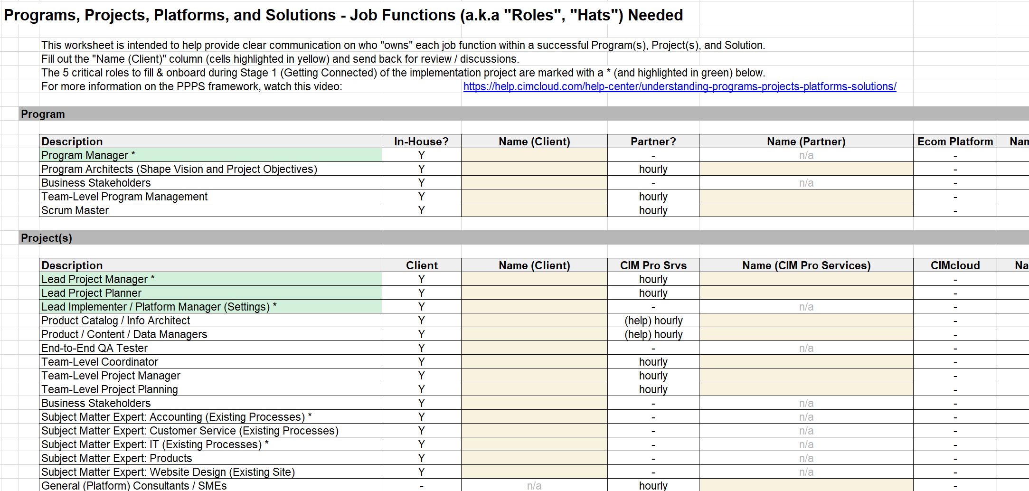
The Critical Roles
The 3PS “Org Chart” Role Assignment Worksheet

Slide 32
Today’s Agenda
Why? The Business Case
The Ultimate B2B Goal/Vision & Key Driver to Get There
Intro To The 3PS Framework
A Proven Approach For Long-Term eCommerce Success
Program & Projects
One Long-Term Program w/ Lots of Short-Term Projects
Platform(s) vs. Solution
Explaining Your Solution vs. Platform(s) You Buy
Critical Roles (“Hats”) to Fill
The Critical Roles That Must Be Filled for Success
First / Next Steps
Six (6) Steps You Can Take Now

Slide 33
First / Next Steps
Six (6) Steps You Can Take Now
Step #1 = Assign a Program Manager
Step #2 = Complete the 3PS “Org Chart” (Role Assignments)
Step #3 = Make Sure All Roles are Filled with “GWC” Fit
Step #4 = Clarify Your Next / Current Project Outcome(s)
Step #5 = Build a Plan (or Gap Plan) to Achieve the Outcome(s)
Step #6 = Execute the Plan (with All Roles Filled)
Question: Should you run multiple concurrent projects?

Slide 34
First / Next Steps
Want More Content / Tools?
A few of the CIM Playbook topics/tools not covered today…
All 3PS Roles (& Responsibilities) By Implementation, Roll-out, and Operations Stages
Customer Interaction Health Check / Score (0 to 100)
Major Processes for Ongoing Program, Projects, and Solution Operations
Program Planning Tool: 8 Steps to Grow Sales, Not Headcount
Solution Size & Complexity
To Customize or Not? (Business Value Chain Considerations)
Filling Roles: Hire In-House vs. Firms / Agencies / Partners
Platform Version Update Project Tracking Sheet & Test Matrix Template
Platform Replacement Risk Assessment & Risk Management Strategies
Customer IQs (Interaction Questionnaires)

Slide 35
Want More Content?
Contact Us at cimcloud.com

